Slide 1
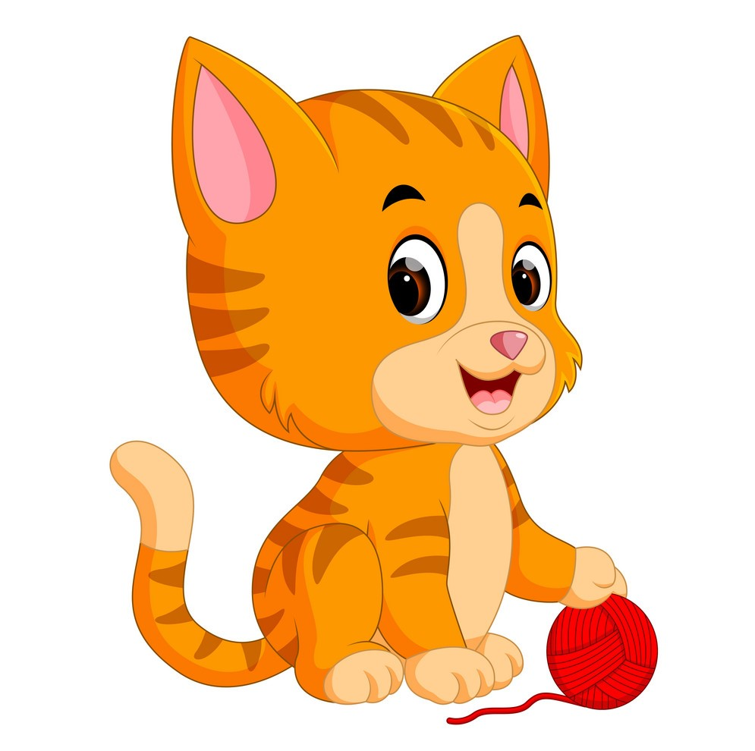



Wildlife preservation and domestic cats
Possum Media

Slide 2
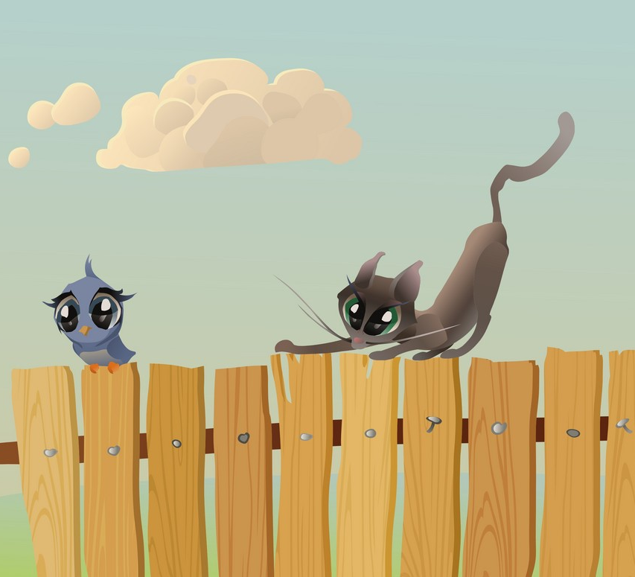
Problem Statement
Free ranging domestic cats are threatening the wildlife.
Driven by cat owner’s lack of knowledge and little day and night cat confinement.
Free roaming domestic cats hunt approximately 25.6 million wildlife animals each year!
(Grayson, Calver & Michael, 2016)
Notes:
Grayson, J, & Calver, Michael. (2016). Reducing Wildlife Predation by Domestic Cats: An Approach Based on the Precautionary Principle..

Slide 3
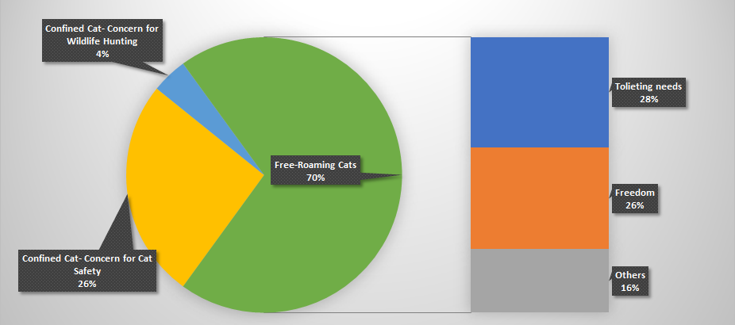
Cat owner’s confinement behaviour
MacDonald, E., Milfont, T., & Gavin, M. (2015).

Slide 4
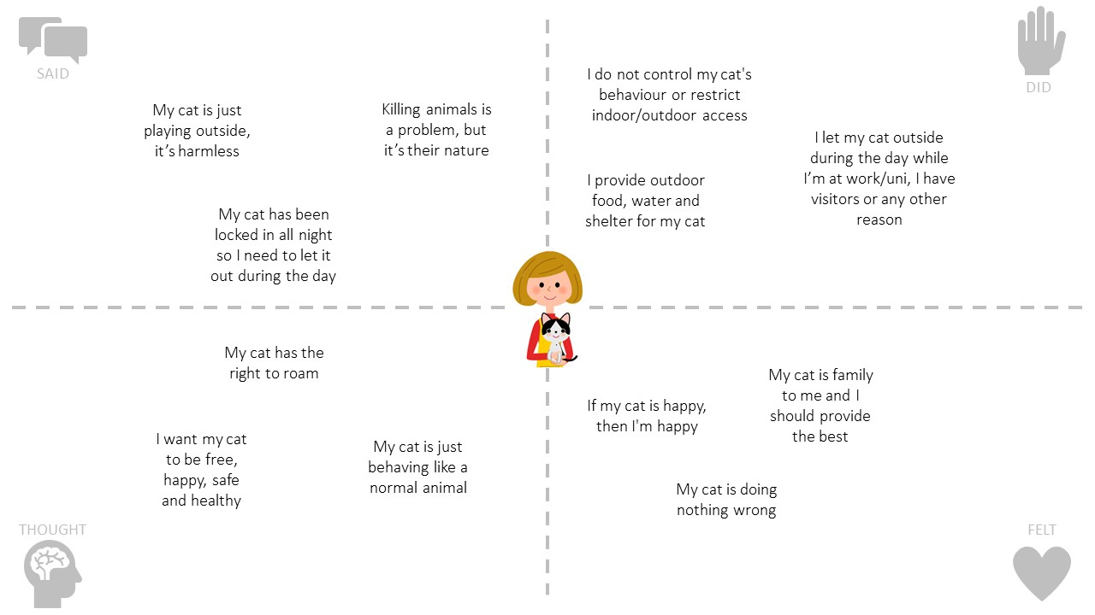
Empathy map
Coetzer, E. P., & Rothmann, S. (2003).
Petplan,(2016)
Grayson & Calver(2004)

Slide 5
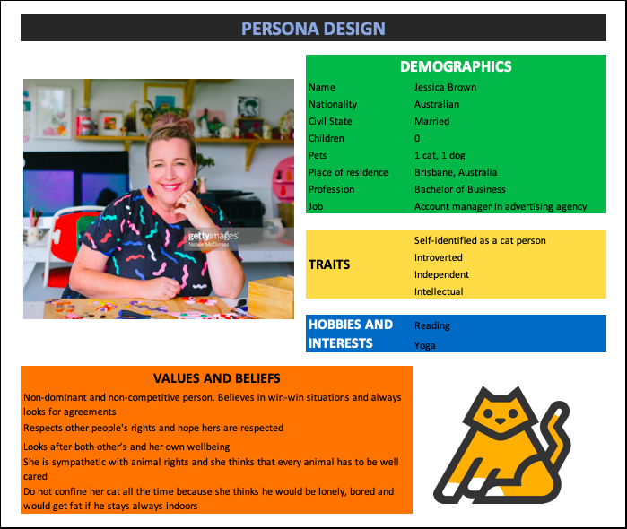
PERSONA DESIGN
Female cat owners aged 25 - 35
Jessica Brown, 35 years old
A very independent, easy going person
Non-dominant and non-competitive
Looks after others and well as her own wellbeing.
Respect other people’s rights and respect them
Respects animal rights and is aware of cat’s predation on wildlife but her cat is priority
Loves cats, a typical cat person
Spends $5000 per year on her cat
Does not confine her cat permanently
Believes her cat would be lonely, bored and would get fat if left indoors
Coetzer, E. P., & Rothmann, S. (2003).
Petplan,(2016)
Grayson & Calver(2004)
GettyImages. (2019, May 9)

Slide 6

Social change goals

Slide 7

Social change program aim
The program will increase the current 24-hour cat confinement rate of 30% to 50% in Queensland by targeting female cat owners aged 25-35 through enriching indoor environments by the end of December 2020.

Slide 8
Social change objectives
Behaviour objective: Female cat owners (aged 25-35) providing their cats with enriched opportunities beyond basic necessities (food, water, bedding) during confinement will increase by the end of June 2020 by 25%.
Knowledge objective: Female cat owners’ (aged 25-35) knowledge that 100% of the cat’s exercise needs can be met with proper enriched indoors and plays will increase by the end of October 2020 by 20%.
Belief objective: Female cat owners’ (aged 25-35) belief that 24-hour cat confinement causes boredom and health problems (obesity, diabetes, urinary tract disease, respiratory disease etc.) among their companion cats will decrease by the end of November 2020 by 20%.

